Slide 1
Atomic Structure and the Periodic Table

Slide 2
Elements
You should know the names and symbols of the important elements
You should know the names, symbols and charges of the important ions (see objectives list)
You should know how to determine the protons, neutrons and electrons for atoms and ions using their mass number and atomic number

Slide 3
Dalton’s atomic theory
Dalton postulated the following:
Elements consist of small, indivisible atoms.
Atoms of an element are all identical.
Elements of different atoms have different properties.
Compounds are combinations of atoms of different elements.
The relative numbers of atoms of different elements in a compound are definite and constant.
Different compounds may exist which contain the same elements combined in different proportions.

Slide 4
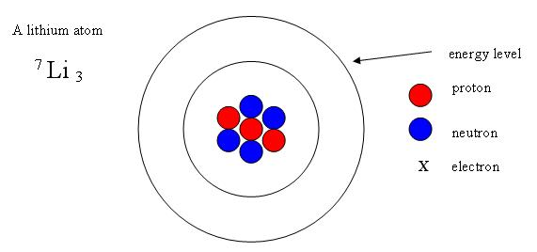
The structure of the atom
We now know that atoms are made up of protons, neutrons and electrons.
The protons and neutrons form the nucleus of the atom and the electrons move around the nucleus as a rapidly moving cloud.

Slide 5


Slide 6
An ATOM is mainly empty space !
If the MCG represents the size of a typical atom, then its
nucleus would be the size of a marble and would be located
at the centre bounce –down.

Slide 7
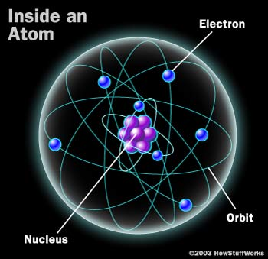

Slide 8
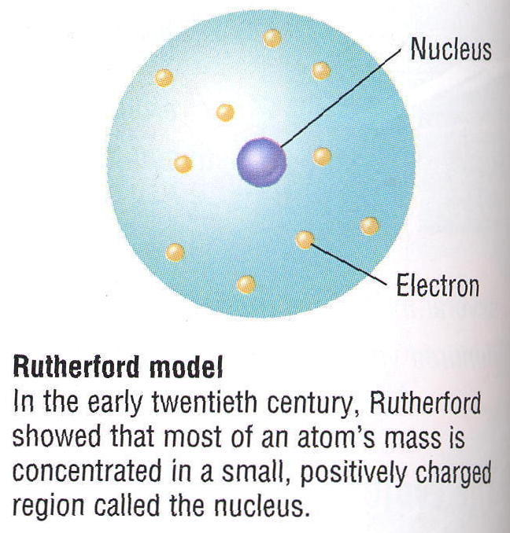

Slide 9
Rutherford fired alpha particles (two P and two N) at a thin sheet of gold foil.
He suspected that the alpha particles would pass through but found a significant number were deflected.
Activity 1.1 on page 105 of Nelson

Slide 10
Properties of p, n and e⁻
Particle | Symbol | Mass (kg) | Relative Mass | Charge
Proton | p | 1.673 x 10⁻²⁷ | 1 | +1
Neutron | n | 1.675 x 10⁻²⁷ | 1 | 0
Electron | e- | 9.110 x 10⁻³¹ | ~1/1840 | -1

Slide 11
The nucleus
Most of the mass of the atom is concentrated in the nucleus. (99.9%)
The diameter of the nucleus (~10⁻¹⁵m) is negligible compared to the diameter of the whole atom (~10⁻¹⁰m).
The nucleus contains the protons and neutrons.
The nucleus has a positive charge equal to the number of protons.
The nucleus is very dense.

Slide 12
The electrons
The electrons exist in principal energy levels (or shells) around the outside of the nucleus and define the extent/diameter of the atom.
The shells make up most of the volume of the atom.
In an uncharged atom (not an ion) the number of electrons equals the number of protons in the nucleus.

Slide 13
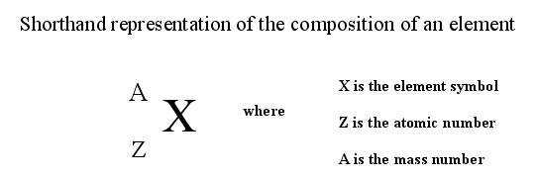
Shorthand representation of the composition of an element
Z, the atomic number, tells us the number of protons in the nucleus. It also tells us the number of electrons in the orbital's of an atom if the atom is neutral.
A, the mass number, tells us the number of protons plus neutrons in the nucleus of an atom.

Slide 14
Worked example 1.1 (Teacher)
Question Set 1.1 (For question 3 you will need to have done pre-reading)
Worksheet (if you need more practice)

Slide 15
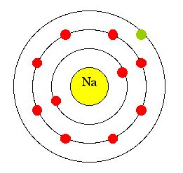
Electrons in atoms (revision)
Electrons are found in positions called shells or energy levels
Each shell can only have a maximum number of electrons (2,8,8)
Valence e⁻

Slide 16
You try
Draw the model of the atom chlorine showing the shells and electrons
Write the electron structure for chlorine

Slide 17
Ions
Ions are electrically charged species formed when atoms gain or lose electrons.
Positive ions, or cations, are formed when one or more electrons are removed from an atom. The resulting ion therefore has more positively charged protons than the negatively charged electrons.
K → K⁺ + e⁻
e.g.
Potassium atom becoming a potassium ion
K | K⁺
19 protons | 19 protons
19 electrons | 18 electrons
Charge zero | Charge +1

Slide 18
Ions
Ions are electrically charged species formed when atoms gain or lose electrons.
Negative ions, or anions, are formed when one or more electrons are accepted by an atom. The resulting ion therefore has more negatively charged electrons than positively charged protons.
Cl + e⁻ → Cl⁻
e.g.
Chloride atom becoming a chloride ion
Cl | Cl⁻
17 protons | 17 protons
17 electrons | 18 electrons
Charge zero | Charge -1

Slide 19
Ions have the same valence electron structure as a noble gas
Known as the octet rule
Stability of the valence electron shell

Slide 20
Isotopes
Isotopes are atoms of the same element (same number of protons) that have different numbers of neutrons in the nucleus.
Can have different physical properties such as colour, density or nuclear stability (radioactive decay).
oxygen-16 oxygen-17 oxygen-18

Slide 21
Relative atomic mass
Compares the mass of an atom to the mass of another atom
Carbon-12 is the standard for comparison (mass 12)
One titanium atom has the same mass as four carbon atoms so relative atomic mass of 48.

Slide 22
So why is Carbon 12.01?
Reflects the abundance of isotopes of the same element.
Mass number = (abundance % x atomic mass) +(abundance percentage x atomic mass)/100
Worked example (Teacher)
Question set 1.2
Activity Sheet 1.3

Slide 23
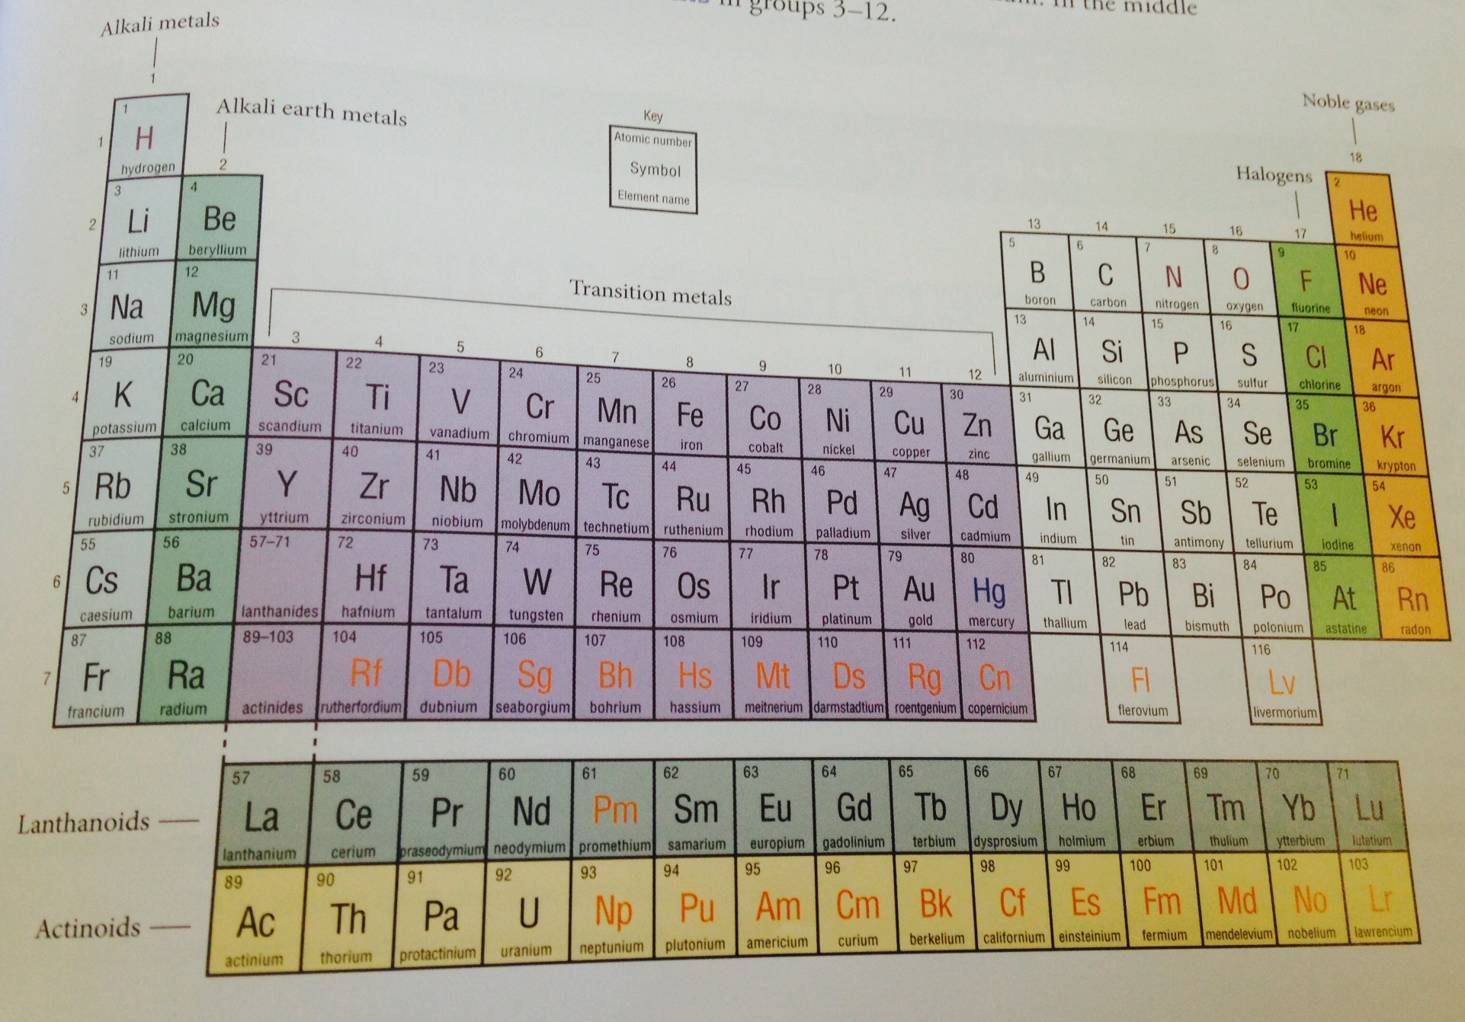
The periodic table

Slide 24
Groups and periods
Atomic number
Metals, non metals and metalloids
Reactivity
DVD
Question Set 1.3 Nelson
Activity sheet 1.4 Nelson online

Slide 25
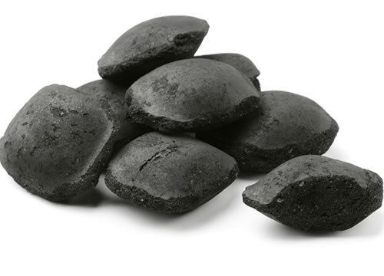

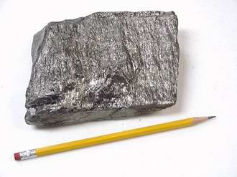
Carbon
Allotrope is a different physical form of the same element due to arrangement of atoms
Diamond, graphite and coal are all carbon

Slide 26
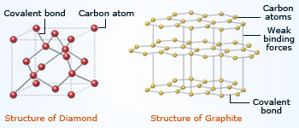

Slide 27
Energy levels (or shells)
They are denoted by the numbers 1,2,3,4,…
These numbers are called principal quantum numbers (n)
Simple electron configurations just shows the number of electrons in each energy level.
e.g. potassium 2,8,8,1
chlorine 2,8,7

Slide 28
Principal energy levels (or shells)
The last numbers in these sequences (the 1 and 7) are called ‘valence electrons in the outer shell’ and are the electrons involved in bonding.
The rest of the electrons are called ‘inner shell electrons’ and shield the outer valence electrons from the nuclear charge.
The maximum number of electrons at each of the first 5 levels are 2, 8, 18, 32, and 32 calculated by the formula 2n²
The energy levels can be further subdivided into subshells and orbitals.

Slide 29
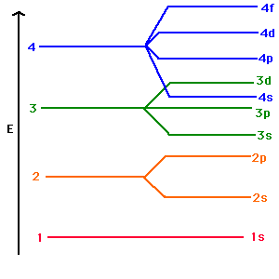
Subshells and orbitals
The principal energy levels of electrons in atoms can be arranged into subsets which are labelled s, p, d and f and are called subshells.
The subshell energy levels can be arranged into subsets called orbitals.
The s subshell has one orbital
(spherical in shape)
The p subshell has three orbitals
(figure 8 shaped)
The d subshell has five orbitals (complicated lobe shape)
The f subshell has seven orbitals
(complicated lobe shape)

Slide 30
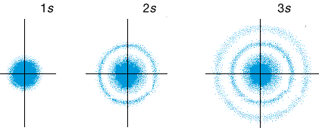
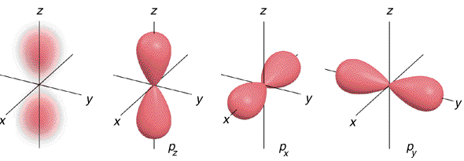
_{s and p subshells}
2p_{z}
2p_{x}
2p_{y}

Slide 31

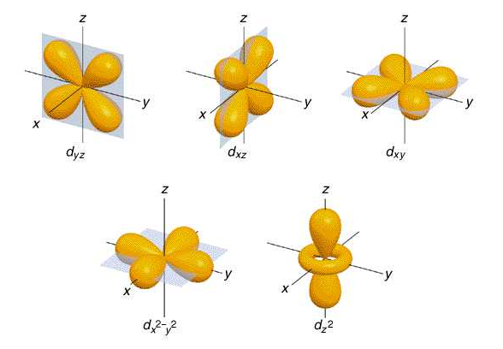
d subshells

Slide 32
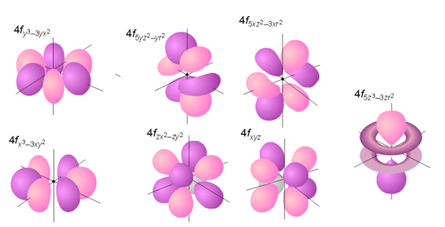
f subshells

Slide 33
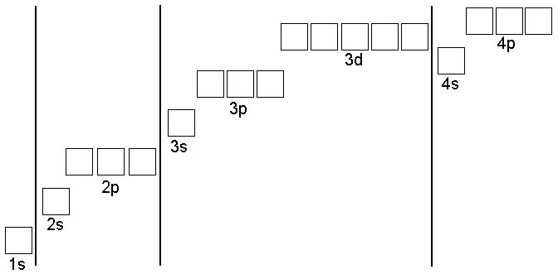
Orbitals in each subshell

Slide 34
The electron configurations of the elements
To determine the electron configuration of an atom in its lowest energy or ground state:
Place the electrons into orbitals starting with the lowest energy orbitals first.
Place a maximum of 2 electrons into each orbital

Slide 35
Try it yourself worksheet (first 4)

Slide 36
  Energy level 1 1 orbital 2 electrons
  Energy level 2 4 orbitals 8 electrons
  Energy level 3 9 orbitals 18 electrons
  Energy level 4 16 orbitals 32 electrons
Electrons will move into the fourth orbital before the third energy level’s orbitals are full.
When you get to the third shell;
- put 8 e⁻ in shell three
- then put 2 in shell four
- then go back and put the next 10 in shell three
or until it reaches 18.

Slide 37
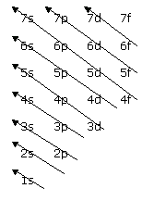
Order of filling energy sublevels
Increasing energy

Slide 38
Try it yourself worksheet (last two)
Question set 1.4 Nelson
Activity sheet 1.2 Nelson online

Slide 39
Ionic radius
Ions aren’t the same size as the atoms they come from.
Positive ions are smaller than the atoms they come from. They lose their outer shell when they lose their valence electrons, and in addition their remaining electrons are being attracted by the force of a greater nuclear charge.
Negative ions are bigger than the atoms they come from. The incoming electron moves into the outer shell, but now the nuclear charge has to hold extra electrons. The repulsion that occurs causes the atoms to expand.

Slide 40
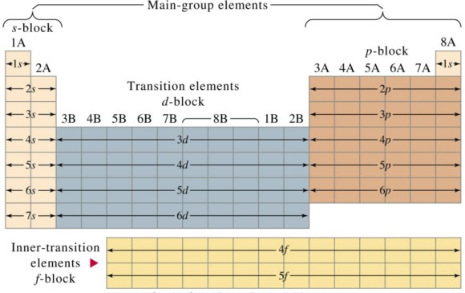
Electron configurations and the periodic table
When elements are listed in order of increasing atomic number, similar outer electron configurations occur at regular intervals.
Elements with similar electron configurations in their outer energy levels have similar properties.
In the periodic table, elements
with the same outer energy
level configurations occur in
the same vertical group.
See p18-21

Slide 41
Electron configurations and the periodic table
Note the following points:
The group number corresponds to the number of electrons in the outer principal energy level.
The period number corresponds to the number of the principal energy level in which the outermost electrons are located.
Elements in groups 1 & 2 have one and two electrons in their outer principal energy level. These are in the s sublevel and the elements are known as s block elements.
Elements in groups 3 to 8 arise from the progressive filling of the p sublevel of the outer principal energy level and are called p block elements.
The transition elements arise from the filling of the five orbitals of a d sublevel in periods 4, 5 and 6.
The lanthanide and actinide series arise from the filling
of the 4f and 5f sublevels respectively.

Slide 42
Ionisation energies
It is possible to remove one or more electrons from an atom to form a positively charged ion.
Energy is required to do this, as the electron must be removed from the electrostatic force of the positively charged nucleus.
The energy required is called the ionisation energy and is usually quoted in kJ mol⁻¹.

Slide 43
Ionisation energies
Definitions
The ionisation energy of an atom or ion is the amount of energy required to remove the most loosely bound electron from the atom or ion in the gaseous state.

Slide 44
Ionisation energies
The first ionisation energy is the energy required to remove one electron from each atom in 1 mole of gaseous atoms to form 1 mole of gaseous 1+ ions.
M(g) + energy → M⁺(g) + e⁻
Gaseous metal
Gaseous metal ion

Slide 45
Ionisation energies
There are three main things that affect the size of ionisation energies:
Atomic radius – the further the outer shell electrons are from the positive nucleus, the less they’ll be attracted to the nucleus. So ionisation energy will be lower.
Nuclear charge – the more protons there are in the nucleus, the more it’ll attract the outer electrons, so the ionisation energy will be higher.
Electron shielding – the inner electrons shield the outer electrons from the attractive force of the nucleus. The more inner shells of electrons there are the more shielding, so lower ionisation energy.

Slide 46
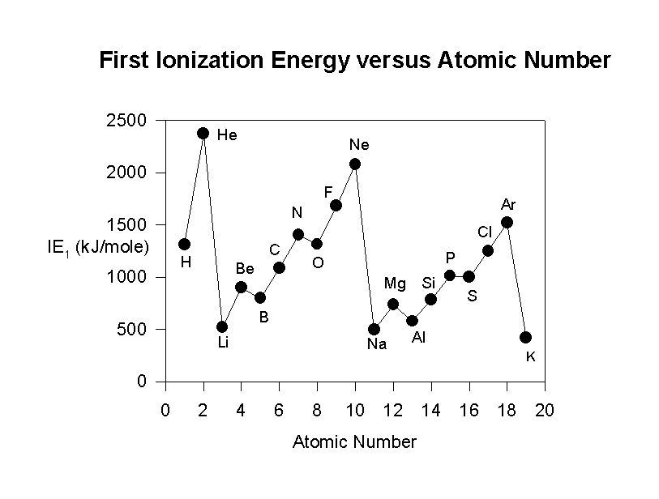
Trends in first ionisation energies
As you move across a period of the periodic table, first ionisation energies increase.
Why?
As you move down a group of the periodic table, first ionisation energies decrease.
Why?
How is this able to be used
as evidence for the e⁻
configuration of atoms?

Slide 47
Successive ionisation energies
It is possible to remove all the electrons from an atom leaving just the nucleus.
Each time you remove an electron there are successive ionisation energies.
The second ionisation energy is the energy required for the process:
M⁺ (g) + energy → M²⁺ (g) + e-

Slide 48
Successive ionisation energies
There can also be third, fourth, fifth etc.. ionisation energies.
The successive ionisation energies of atoms have progressively larger values because the electrons are being removed from progressively larger positive charges.
See the table below, showing the successive ionisation energies for sodium.

Slide 49
Successive I.E. for Na
Why are there large jumps between the 1st and 2nd ionisation energies and also between the 9th and 10th ionisation energies?

Slide 50
Electronegativity
The electronegativity of an atom is a numerical measure of the electron attracting power of the atom.
Non-metals have higher electronegativities.
Metals have lower electronegativities.
Electronegativities increase across periods:
This can be explained in terms of the increase in nuclear charge across a period. Although an extra electron is added for each element, this does not fully shield the effect of the increased nuclear charge.
Electronegativities decrease down groups:
This is because the size of the atoms increases and the attractive force of the shielded nucleus is decreased.

Slide 51
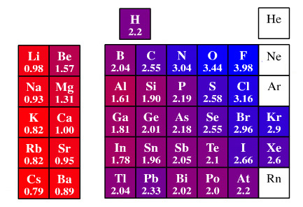
Electronegativity

Slide 52
Valence electrons
The valence electrons of an atom are the electrons in the outer principal energy level.
They largely determine the chemical properties of an element.
The number of valence electrons can be determined by the successive ionisation energies for an element. (See earlier)

Slide 53
Number of valence electrons and bonding capacity
Bonding capacity is a concept that can be used to predict the number of bonds an atom can form (in covalent molecules), or the charge that it can develop (in ionic substances).
Non-metal in a covalent molecular substance
Atoms tend to achieve stability by obtaining a full outer shell of electrons, so the number of valence electrons determines how many bonds are needed to be formed to achieve this.
e.g. carbon has 4 valence electrons, and so needs to share in 4 more electrons, or 4 more bonds to achieve stability.
So it could form 4 single bonds OR 2 double bonds OR a single and a triple bond.

Slide 54
Number of valence electrons and bonding capacity
Bonding capacity is a concept that can be used to predict the number of bonds an atom can form (in covalent molecules), or the charge that it can develop (in ionic substances).
Metals and non-metals in ionic substances
Metals lose electrons to achieve a full outer shell and so become positively charged.
Non-metals gain electrons to achieve a full outer shell and so become negatively charged.
This then affects the ratio of ions in an ionic lattice.
e.g. calcium chloride, CaCl₂

Slide 55
Position on the Periodic Table
As discussed previously, the number of valence electrons an atom possesses determines its position on the Periodic Table.
Atoms with the same number of valence electrons are placed in vertical columns called groups, with groups of atoms undergoing similar chemical reactions and therefore having similar chemical properties.
The number of valence electrons also determines whether an atom is a metal or non-metal element. This governs the type of bonding it has and therefore its physical properties.
e.g. iron (metallic lattice) versus oxygen (diatomic gas)

Slide 56
Electron configurations of atoms
Revision: The nature of light
Energy is transmitted by means of electromagnetic radiation i.e. visible light, x-rays, infrared radiation, UV radiation etc…
The energy is transmitted in the form of wave motion.
Different forms of radiation have different wavelengths and frequencies.

Slide 57
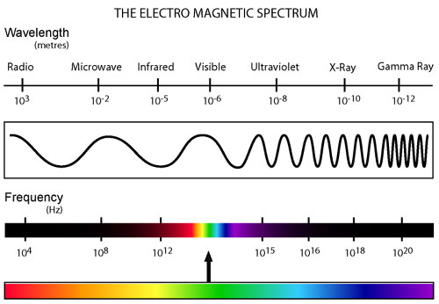
The electromagnetic spectrum

Slide 58
Visible light
Visible light contains different frequency electromagnetic radiation visible to the human eye as different colours.
When white light is passed through a prism the electromagnetic radiation of varying frequencies form a continuous spectrum
ROYGBIV

Slide 59
Bohr's Model of the Hydrogen Atom
Line Spectra provide evidence for Bohr’s model.
Lasers emit radiation which is composed of a single wavelength. However, most common sources of emitted radiation (i.e. the sun, a light bulb) produce radiation containing many different wavelengths.
When the different wavelengths of radiation are separated from such a source a spectrum is produced.
ROYGBIV

Slide 60

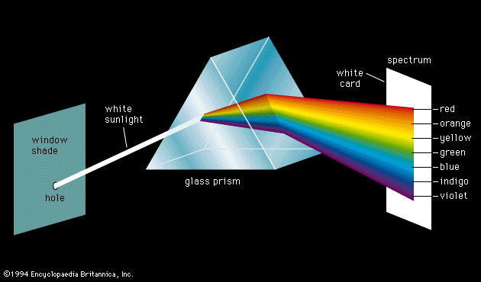
Bohr's Model of the Hydrogen Atom
A rainbow represents the spectrum of wavelengths of light contained in the light emitted by the sun.
Sun light passing through a prism (or raindrops) is separated into its component wavelengths
Sunlight is made up of a continuous spectrum of wavelengths (from red to violet) - there are no gaps

Slide 61
Bohr's Model of the Hydrogen Atom
Not all radiation sources emit a continuous spectrum of wavelengths of light.
When high voltage is applied to a glass tube containing various gases under low pressure different coloured light is emitted
  Neon gas produces a red-orange glow
  Sodium gas produces a yellow glow
When such light is passed through a prism only a few wavelengths are present in the resulting spectra
  These appear as lines separated by dark areas, and thus are called line spectra

Slide 62
Bohr's Model of the Hydrogen Atom
Demo “Gas discharge tubes”
Experiment 7
“Fireworks and flame tests”

Slide 63
Bohr's Model of the Hydrogen Atom
When the spectrum emitted by hydrogen gas was passed through a prism and separated into its constituent wavelengths four lines appeared at characteristic wavelengths.
The line emission spectrum for hydrogen is shown below.
Excited hydrogen atoms emit light of certain frequencies only

Slide 64
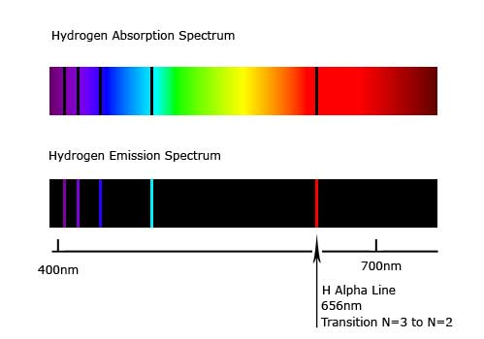
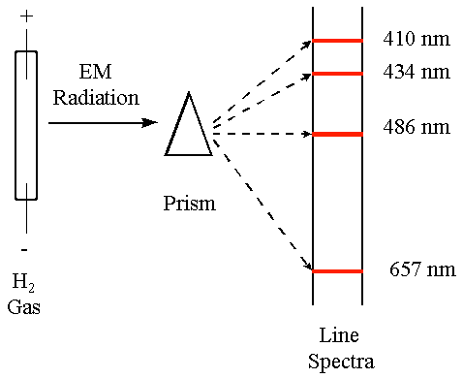
Bohr's Model of the Hydrogen Atom
Each element has a unique emission spectrum

Slide 65
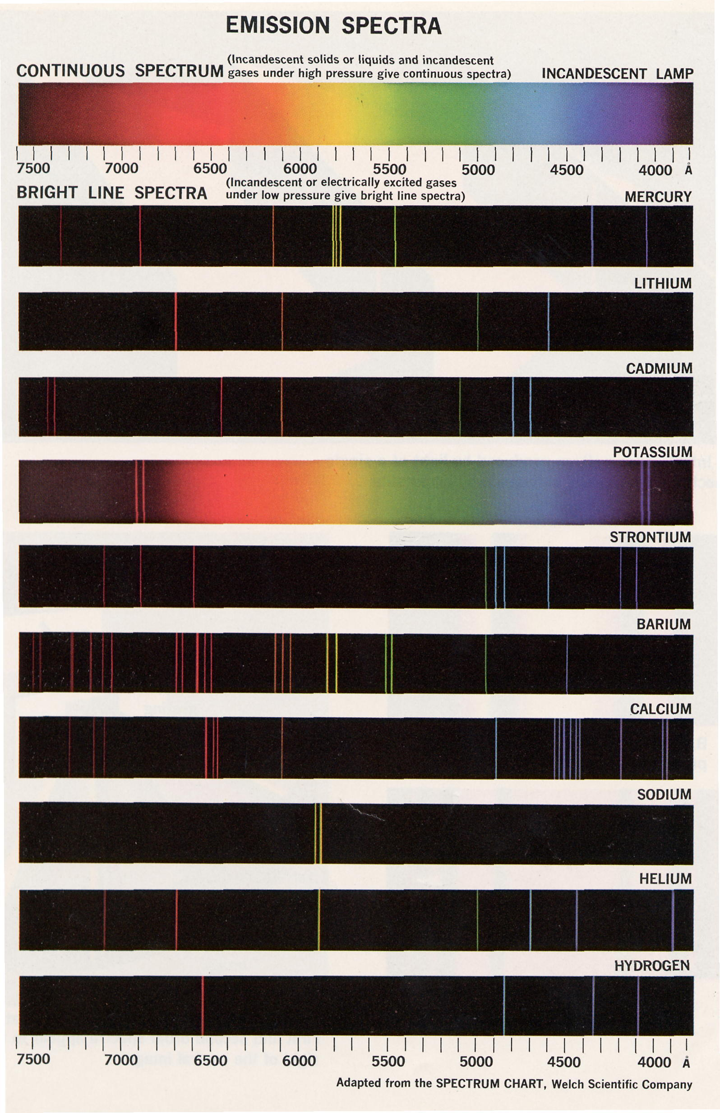

Slide 66
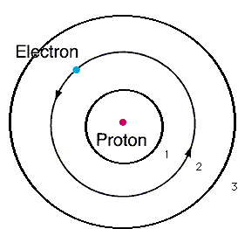
Bohr's Model
In 1913 Bohr proposed that in a hydrogen atom the electron moves around the nucleus in a circular orbit.
He suggested that an electron in an atom could only have a restricted number of energy values.
Only orbits of certain radii and
particular energies were allowed.
Bohr proposed that an electron in one of these allowed energy states can exist without radiating energy.

Slide 67
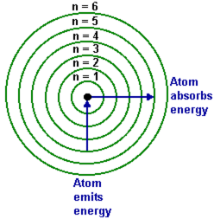
Bohr's Model
In Bohr’s model, each specific orbit or energy level may be identified in terms of a principal quantum number (n) that may have one of the values 1,2,3,4….
The electron in an atom may jump from one of the allowed energy levels to another by the absorption or emission of a definite amount, or quanta, of energy.

Slide 68
Bohr's Model
A line on a spectrum represents a transition from one energy level to another.
When an electron jumps from a higher energy level to a lower one a photon of radiation is emitted.
When the electron in a hydrogen atom is in the first energy level it is said
to be in its ground state.
When an electron is in a higher energy level (n=2 or higher) it is said to be
in an excited state.
So the absorption or emission lines in the spectrum correspond to the transitions of the electron from one energy level to another.

Slide 69
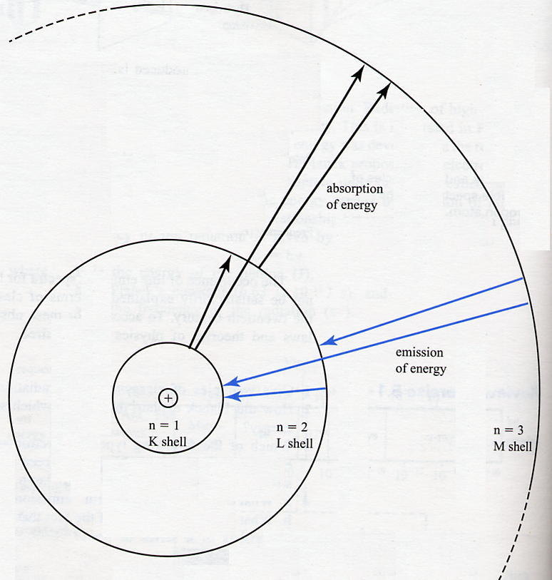
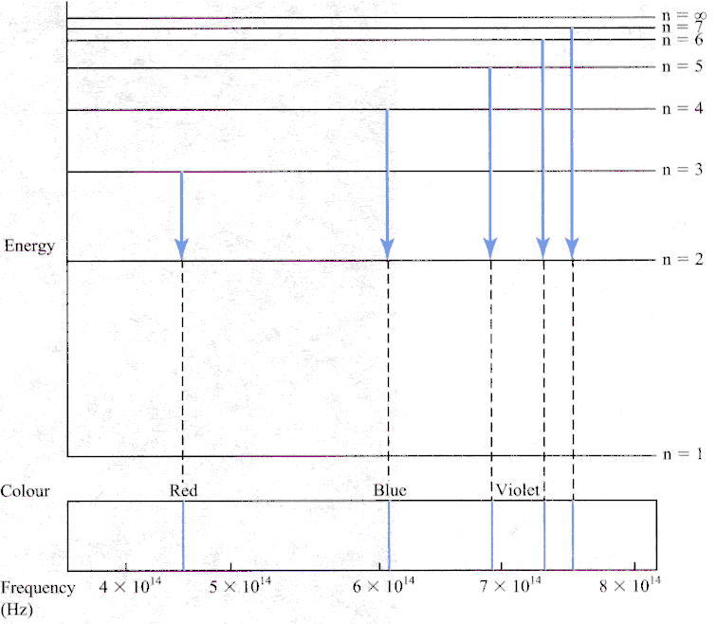
The hydrogen spectrum
The three lowest energy orbits in the Bohr
model of the hydrogen atom
Electron transitions corresponding to the
visible region of the hydrogen spectrum

Slide 70
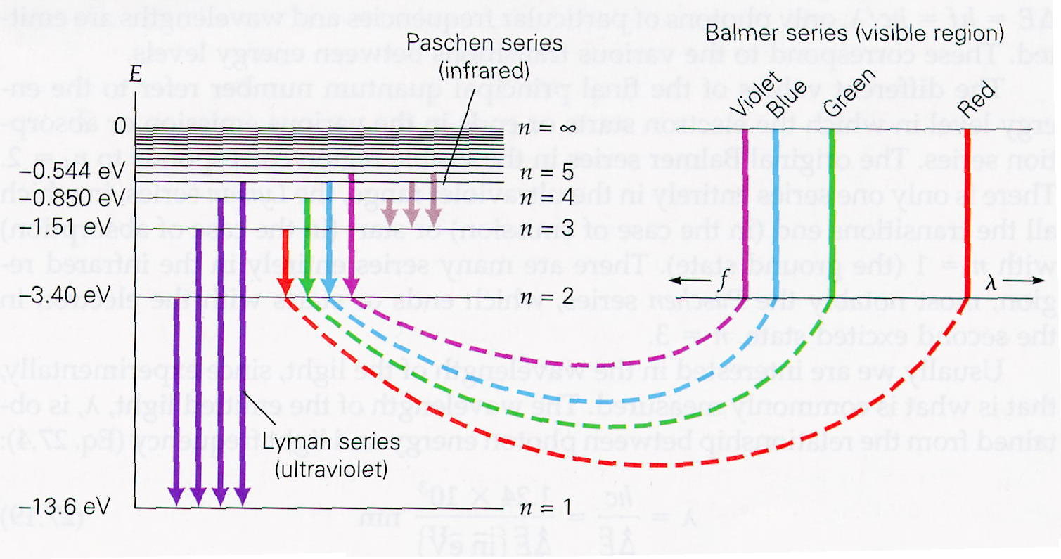
The hydrogen spectrum

Slide 71

Flame tests
  Small quantities of different metal compounds are
  incorporated in fireworks to create various colours:
Sodium YELLOW
Lithium CRIMSON
Strontium SCARLET
Calcium RED
Copper GREEN
Potassium LILAC
Barium YELLOW-GREEN

Slide 72

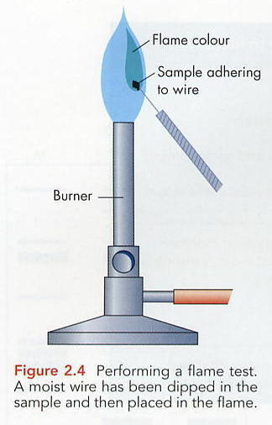
Flame Test - analysis
  Chemists use the fact that some metals produce particular colours when they are heated as a
  convenient method of analysis.

Slide 73
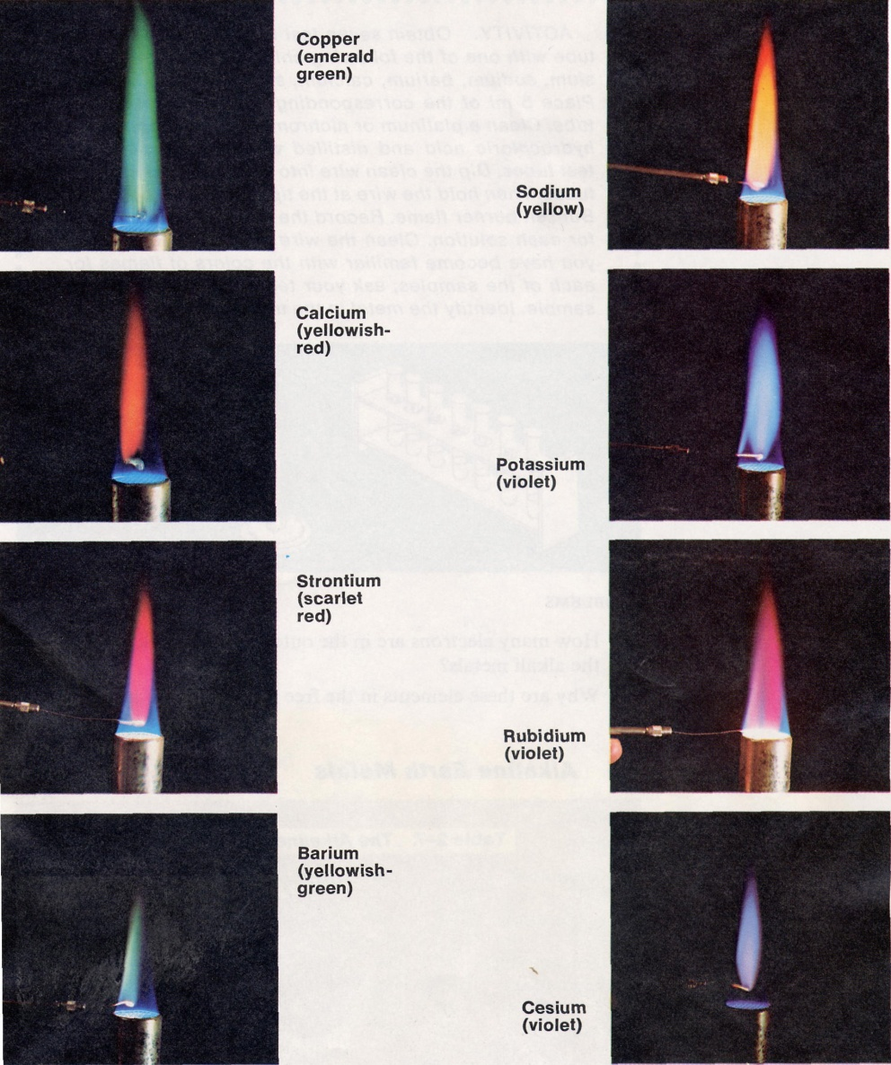
Flame Tests

Slide 74
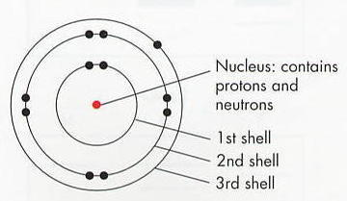
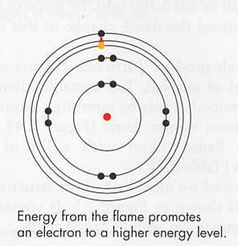
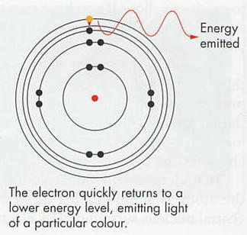
Flame Test - analysis
Electrons jumping between high and low energy levels
produce coloured light during a flame test

Slide 75
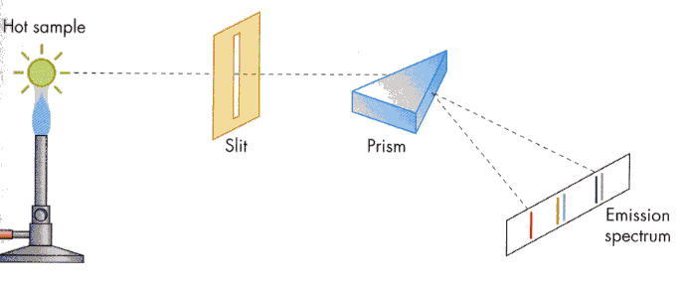
Flame Test - analysis

Slide 76
Bohr's Model - limitations
Bohr’s theory successfully explained the hydrogen spectrum, but failed to deal with atomic spectra of atoms with more than one electron.
It was replaced by the Quantum mechanical model which retained Bohr’s ideas of energy levels.

Slide 77
Some Q’s to do!
Chapter 1 review questions Nelson pg 136
Chapter 1 activity sheet review Nelson online
Chapter 1 online revision quiz Nelson
If you need more questions… ASK!

